Slide 1



Lecture – 9 Directory permissions for Groups and others By: Naveen Tiwari
LINUX ADMINISTRATION
1

Slide 2


File Permissions
Linux system have three types of permissions defined.
Nine characters denotes the three types of permissions.
Eg.
Read (r)
The read permission allows you to open and read the content of a file.
You can't do any editing or modification in the file.
Write (w)
The write permission allows you to edit, remove or rename a file.
Execute (x)
The write permission allows you to run or execute a program.

Slide 3
4. No permission(-)
No read, no write and no execute
Linux File Ownership
Every file and directory on your Linux system is assigned 3 types of owner.
User (u)
A user is the owner of the file.
By default, the person who created a file becomes its owner.
A user is also sometimes called an owner.
2. Group(g)
A user- group can contain multiple users.
All users belonging to a group will have the same Linux group permissions access to the file.

Slide 4
3. Other (o)
Any other user who has access to a file.
This person has neither created the file, nor he belongs to a usergroup who could own the file.
when you set the permission for others, it is also referred as set permissions for the world.

Slide 5
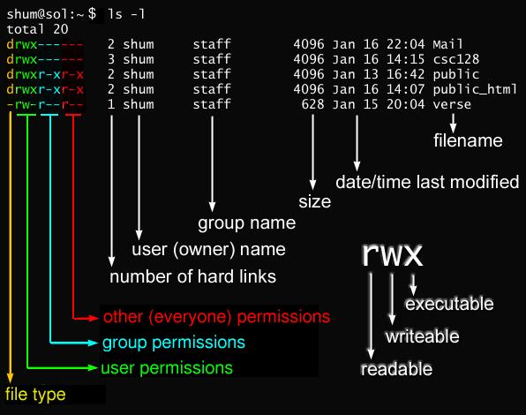

Slide 6
Chmod
change the permissions of a file or folder.
Syntax : chmod <groupName>- <permissionName> <fileName>
Eg:
There are 2 ways to change permissions:
1. Absolute mode 2. Symbolic mode
Absolute node
File permissions are represented as a three-digit octal number.
cmd : chmod 777 abc.txt
Eg :

Slide 7
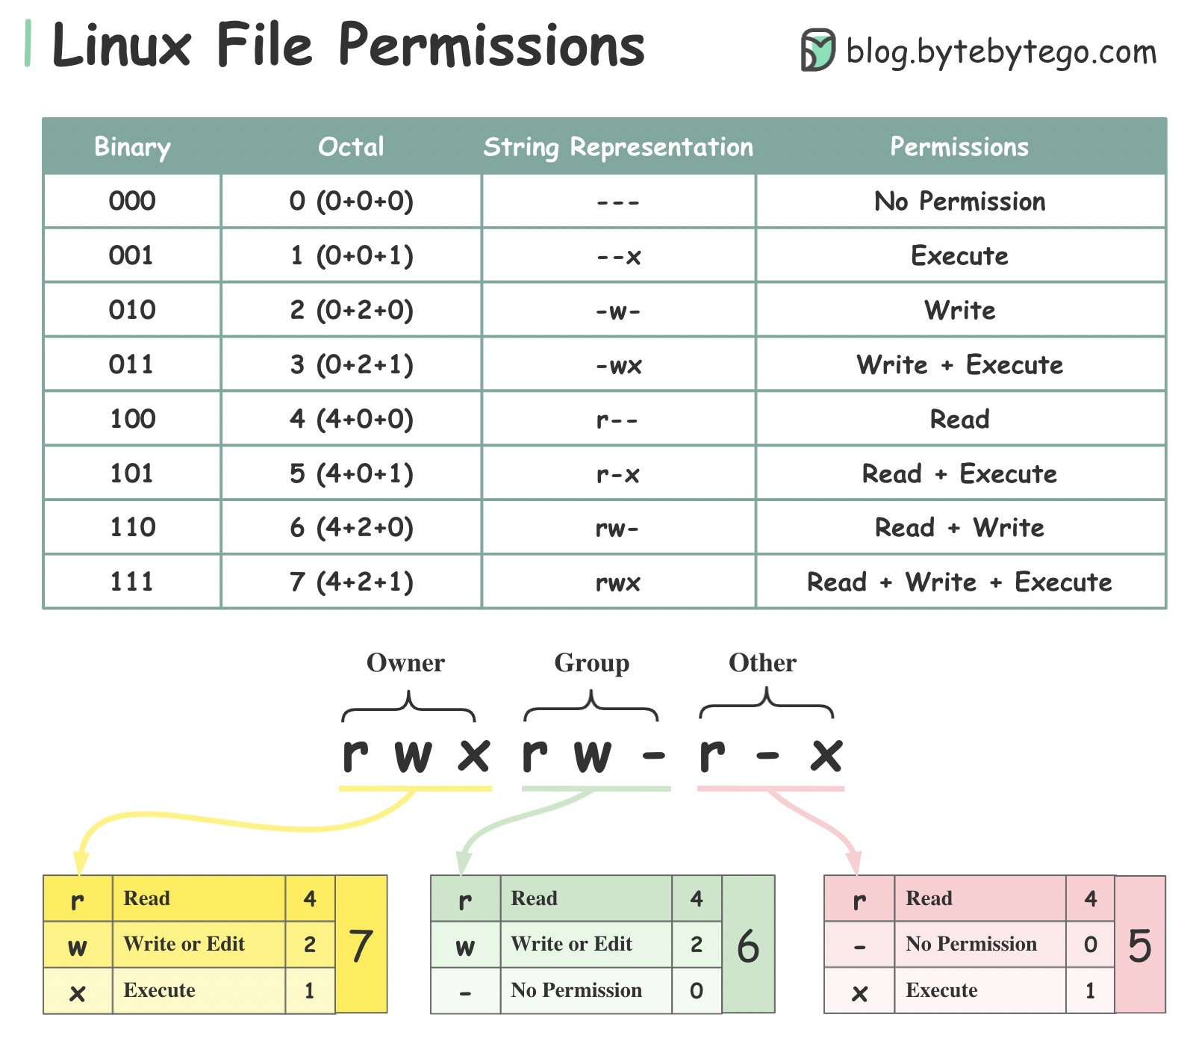

Slide 8
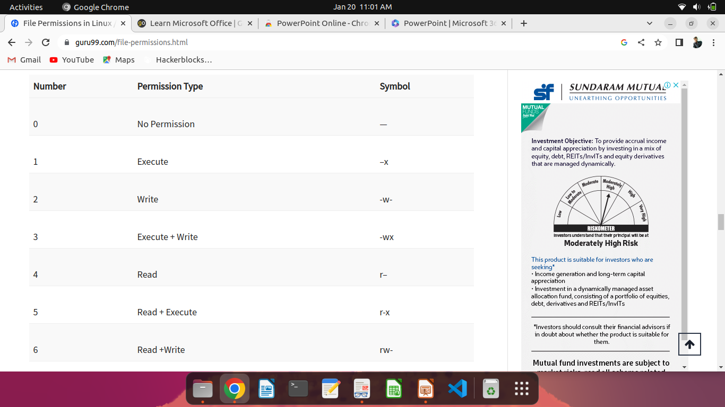

Slide 9
Symbolic node
you can modify permissions of a specific owner.
It makes use of mathematical symbols to modify the Unix file permissions.
User Denotations
u – user/owner
g – group
o – other
a – all
Operator Description
+ Adds a permission to a file or directory
- Removes the permission
= Sets the permission and overrides the permissions set earlier.
To give “execute” permission to the other
cmd : $chmod o+x filename

Slide 10
To give “execute” permission to the other
cmd : $chmod o+x filename
If you want to take all permissions away from everyone
cmd : $chmod ugo-rwx filename
The code above adds read(r) and write(w) permission to both user(u) and group(g) and revoke execute(x) permission from others(o)
cmd : $chmod ug=rx,o+r filename
chown (Changing Ownership)
It changes the ownership of a file.
Syntax : $chown user/uid filelist
Eg :

Slide 11
chgrp (Changing Group Ownership)
chgrp command changes the group ownership of a file.
Syntax : $chgrp group/GID filelist
Eg :

